Slide 1
Project 5 Demo
By Alex D and Aaron M

Slide 2
Project Description
This project will read a keypad to “unlock “ the system
Using the ADC capabilities of the MSP430 we will read the temperature from the LM19CIZ temperature sensor
It will average n amount of measured temperatures
The temperature will be displayed on an LCD along with window size n on the second row
An LED pattern can be selected with the keypad
Display the name of the LED pattern on the LCD on the top row

Slide 3
System Architecture

Slide 4
High level flowchart

Slide 5
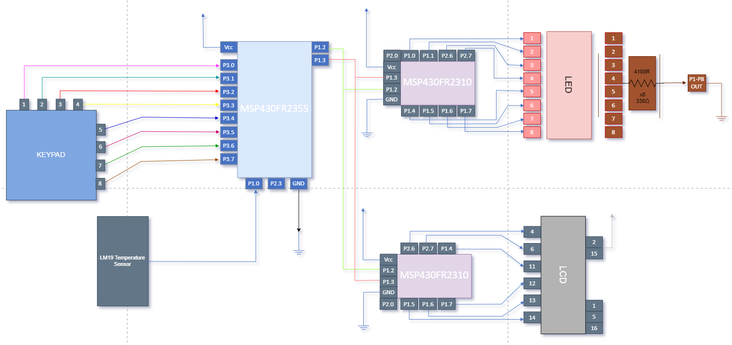
Circuit Diagram

Slide 6
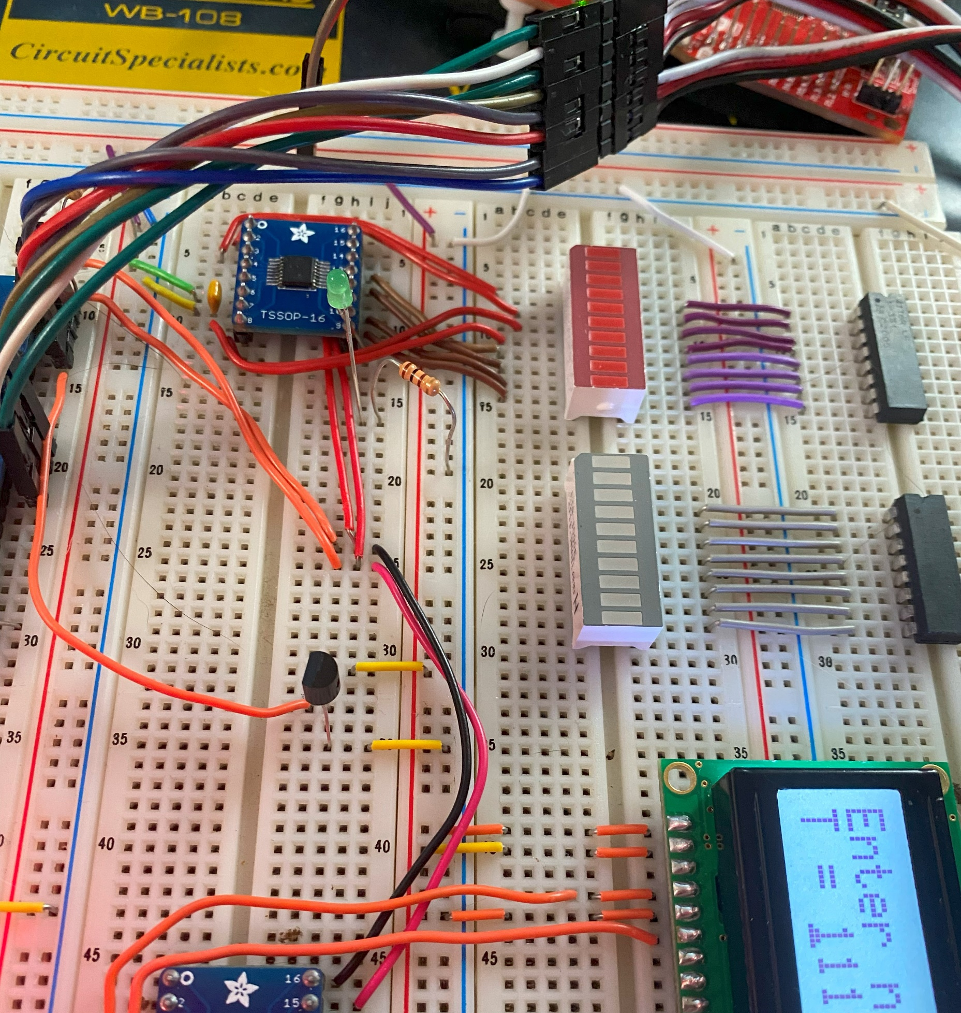

What it should look like

